Slide 1

MIA Pipeline – Registration
Luca Sahli, Jacob Rasmussen and Camilo Mendez MIA-Lab
Fall 2017

Slide 2
Overview
Introduction
Registration evaluation
Affine registration
BSpline registration
Discussion
Outlook
Notes:
First registration approach
The way we optimzed our registration

Slide 3
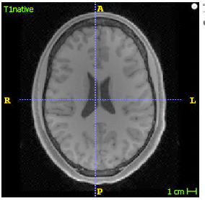
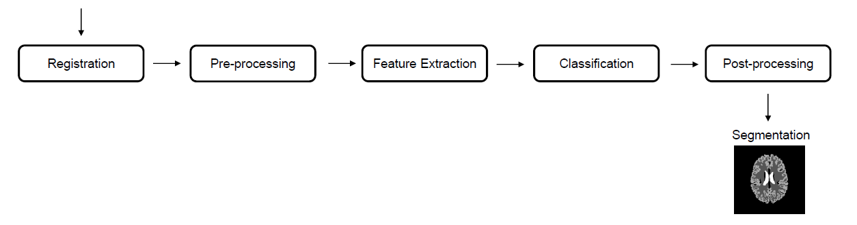
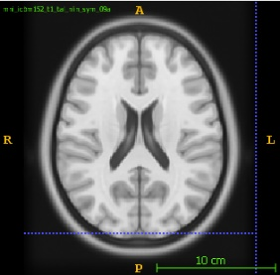
MIA Pipeline
T1 native
T1 mni
Notes:
You are all familiar with the MIA Pipepline. We did our work here in the registration, where we registered a T1…
One Example for this registration could be when a patient takes imagaes on different dates or locations and we have
To register the images to each other.

Slide 4
Registration evaluation
Notes:
You are all familiar with the MIA Pipepline. We did our work here in the registration, where we registered a T1…
One Example for this registration could be when a patient takes imagaes on different dates or locations and we have
To register the images to each other.

Slide 5
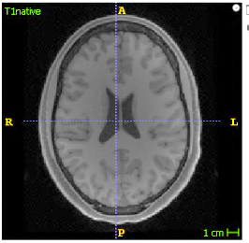
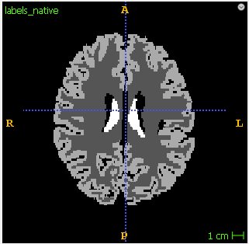
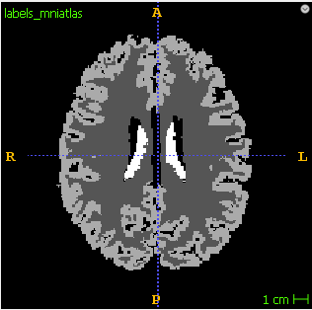
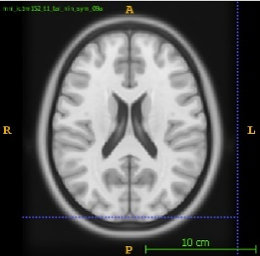
Registration evaluation
T1 native
labels native
labels registered
T
Registration
Transformation
Evaluation
Dice
T1 mni
labels registered
labels mniatlas
Notes:
Now, how do we get the trasnformarion?
This question is answered by jacob.

Slide 6
Affine registration

Slide 7
Affine registration
We use the affine registration class from the MIA Pipeline
Default parameters from SimpleITK
number_of_histogram_bins: [100, 200, 1000]
learning_rate: [0.1, 0.2, 0.9] step_size: [0.001, 0.01, 0.1] number_of_iterations: [100, 200, 1000] shrink_factors: [(2, 1, 1), (4, 2, 1), (8, 4, 1)] smoothing_sigmas: [(2, 1, 1), (4, 2, 1), (8, 4, 1)]
Notes:
Uese method from SimpleITK
There are alot of parameters in to set, we tried to opzimize the following:
Metric: Mutual Information
Optimizer: RegularStepGradientDescent
Multi resolution setup
Time: higher more sampling = longer duration

Slide 8
Optimization
Pseudocode for optimization
FOR EACH Setting of parameters
FOR 10 patients
Dice[White, Grey, Ventricles] = evaluate()
SAVE mean Dice over the 10 patients
CHOOSE setting with highest Dice
Notes:
- Number of histogram bins
- Learning rate
- Step size
- Number of iteration
- Shrinking factor
- Smoothing sigma

Slide 9
Result
Dice coefficients affine transformation
Notes:
Approximatly tested 930 parameter combinations. 14 sec pro patient
Mean
Ventricles big ranges

Slide 10
BSpline registration
Notes:
To optimize the results we had up to now..

Slide 11
BSpline
Affine then Bspline
Use the first registration as initial guess
Two parameters changed:
Interpolator -> BSpline
Optimizer -> LBFGSB
Notes:
LBFGSB
= Limited memory Broyden Fletcher Goldfarb Shannon minimization with simple bounds.
Affine:
Metric = Mutualinformation
Sampling strategie = random
Interpolator = linear
Optimizer = RegularStepGradientDescent
Bspline:
Interpolator = BSpline
Optimizer = LBFGSB

Slide 12
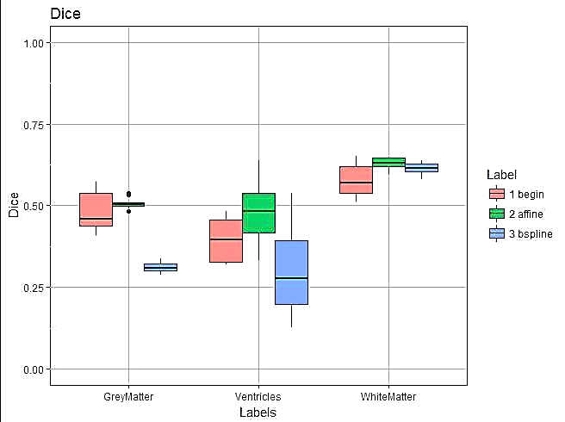
Result 2
Notes:
All dice coefficients got worse after affine

Slide 13
Discussion
Notes:
To optimize the results we had up to now..

Slide 14
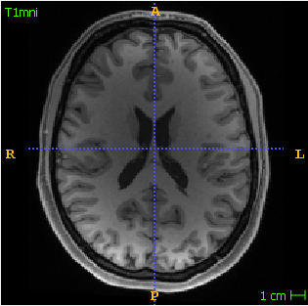
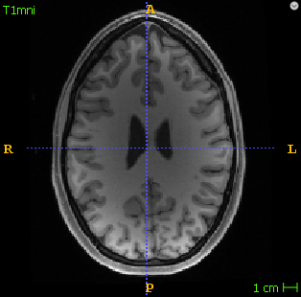
Discussion - Affine
Notes:
Ventricles very different.
Volume factor
0.6 still low
Affine limited

Slide 15
Discussion - BSpline
Notes:
- Definition of a good Registration does not change from affine to Bspline
Optimizer changed from affine to BSpline
Metric changed from affine to BSpline

Slide 16
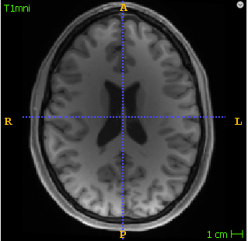
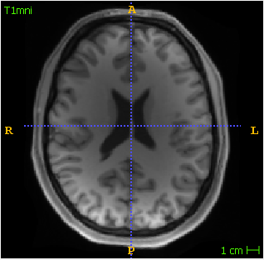
Discussion - BSpline
W = 0.51
G = 0.42
V = 0.33
1
W 0.62
G 0.48
V 0.64
2
W = 0.64
G = 0.31
V = 0.51
3
1
2
3
Notes:
Bspline seems to make a good job
Is the dice coefficient doing what we want?

Slide 17
Outlook
Notes:
Combine transformations (affine and Bspline)
SimpleElastix

Slide 18
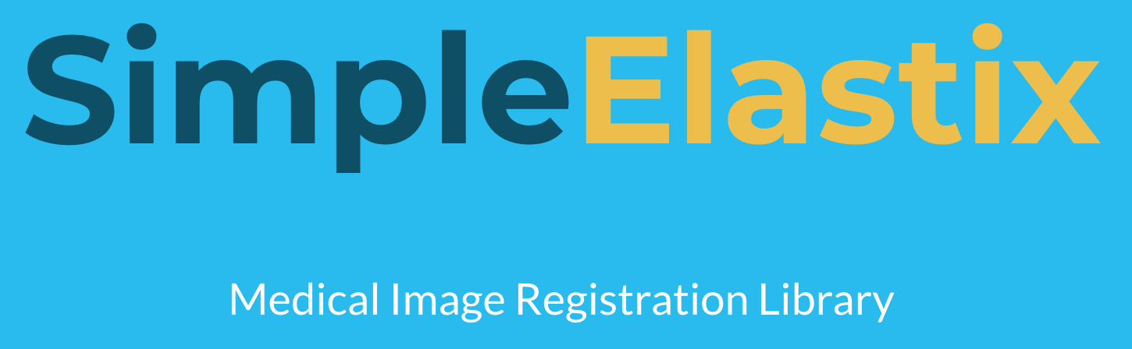
Outlook – SimpleElastix
State-of-the-art medical image registration with a couple of lines of code
Parameter maps to configure the registration procedures
We have found parameter maps which are optimized for brain registrations
Notes:
Parameter maps → easy to change and experiment with different parameters

Slide 19
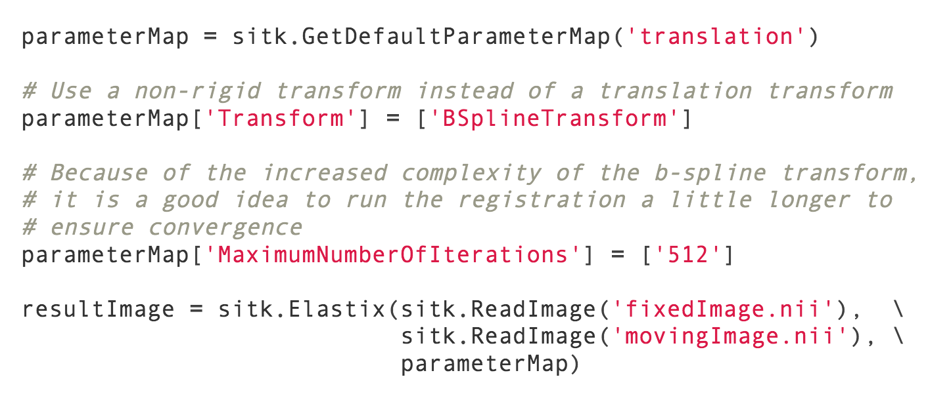
Outlook – SimpleElastix example
Notes:
Combine transformations (affine and Bspline)
SimpleElastix

Slide 20
Questions
Notes:
SimpleElastix

Slide 21
Discussion - BSpline
Dice:
White matter 0.51
Grey matter 0.42
Ventricles 0.33
Dice:
White matter 0.62
Grey matter 0.48
Ventricles 0.64
Dice:
White matter 0.64
Grey matter 0.31
Ventricles 0.51
Notes:
Ventricles very different.
Volume factor
0.6 still low
Affine limited

Slide 22
Conclusions
SimpleItk is a powerful toolkit
contains lots of implemented functions for registration
Limited results for affine transformations
BSpline transformation seem to be very promising
Locally better results (ventricles, bulks in skull)
However, there are difficulties in choosing right parameters.

Slide 23
BSpline Registration
We use methods from the SimpleITK library
number_of_bins: int = 50,
number_of_iterations: int = 1500,
gradient_Convergence_Tolerance: float = 1e-5,
max_number_of_corrections: int = 100,
max_number_of_function_evaluations: int = 1000,
cost_function_convergence_factor: float = 1e+7,
sampling_percentage: float = 0.2,
transformDomainMeshSize = [10,10,10]):
...

Slide 24
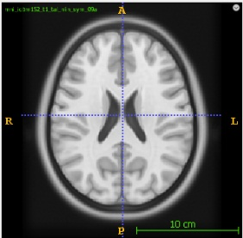
Introduction: Registration Pipeline
1. registration
2. transformation
TAffine
T1_native
T1_mni
labels_
native
Labels_
registerd
TAffine
3. evaluation
Dice
labels_
registerd
labels_
mniatlas

Slide 25
Introduction - sequence
Registration
TAffine
T1_native
T1_mni
TAffine
labels_registerd
labels_native
labels_registerd

Slide 26
Introduction - evaluation
Evaluator
Dice coefficients
labels_registerd
labels_mniatlas/
ground truth

Slide 27
Methods
histList = [10, 50, 100, 200, 300]
learnRateList = [0.1, 0.2, 0.9]
iterList = [100, 200, 1000]
Patient 1
Patient 2
Patient 3
…
Patient 10
..
..
..
..
..
..
..
..
..
..
..
..
..
..
..
mean
..
..
..

Slide 28
Result 2
Begin
Affine
BSpline
Dice:
White matter 0.51
Grey matter 0.42
Ventricles 0.33
Mean 0.42
Dice:
White matter 0.62
Grey matter 0.48
Ventricles 0.64
Mean 0.58
Dice:
White matter 0.64
Grey matter 0.31
Ventricles 0.51
Mean 0.49

